Slide 2
The External Economic Action of the European Union and the Sustainable Development Goals
Filippo Fontanelli – University of Edinburgh – filippo.fontanelli@ed.ac.uk
University of Bologna
3 May – 25 May
8 May 2023
Non-economic values in FTAs

Slide 3
Outline of the module (in progress)
The course’s basic coordinates
  Trade law, investment law and sustainable development: basic notions
  EU competences and policies in trade and investment law
Trade/investment obligations and non-trade values: the return of unilateralism
  The backlash against investor-State arbitration.
  The backlash against trade liberalisation
  Reform proposals for the global investment and trade regimes
  An overview of re-nationalisation trends in trade an investment (US, EU, UK, China)
    Anti-coercion
    Anti-circumvention
    Retaliate against non-MPIA
    Steel row, now sustainable
EU’s external economic action to raise standards abroad
  Free trade agreements and non-economic standards
    Conflict mineral regulation (sort of like diamonds)
    2022 commitment to green trade partnership
    Deforestation MERCOSUR
  Zoom-in: EU dispute with Korea on labour rights
  Zoom-in: level playing field and sustainable development in the Trade and Cooperation Agreement between the EU and the UK
    Mirror clauses
The Carbon Border Adjustment Mechanism
  Overview and assessment of the scheme
  Compatibility with WTO law (China’s complaint at WTO)
  Bonus: carbon removal
Energy (trade)
  EU Net Zero Industry Act and support to renewable energy industry (with assessment of WTO compatibility)
  Reaction to comparable foreign plans (US IRA)
  Zoom-in: biofuels and e-fuels
Energy (investments)
  Foreign investment protection and the fossil fuels industry
  Foreign investment protection and the nuclear energy industry
  Foreign investment protection and the renewable energy industry
  The Energy Charter Treaty, its reform attempts and the withdrawal of EU MS
Controlling trade and investment inbound and outbound flows
  Export restrictions and export controls (including coordinated action with US)
  Critical Raw Materials Act
  EU investment screening
Improving supply chains’ sustainability
  Friend-shoring and sustainable value chains
  Global supply chain due diligence proposal
  EU Guidance to Combat Forced Labor in Supply Chains
  Responsible forestry proposal (trade in forest-risk commodities)
  WTO law-compatibility of these schemes
Promotion of other social interests
  Non-paper of the Commission services 2017 TSD chatpers
  Gender balance in corporate governance in FTAs
  Protection of indigenous peoples’ rights
UNA Europa presentation

Slide 4

Presentations?
For last session, or thematic input into sessions 4 to 9.
Just drop me an email at filippo.fontanelli@ed.ac.uk

Slide 5

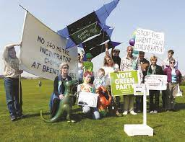

FTAs
UK-EU level playing field
Mirror clauses
Green trade partnership
FTAs and non-economic issues
EU and TSD chapters
Labour disputes
UNA Europa presentation

Slide 6

The role of non-trade interests
From exception to obligation
Conditionality nudge or LPF?

Slide 7
Free trade agreements and sustainable development chapters
TSD chapters
EU practice
Zoom-in: TSD with Korea
2022 Green trade

Slide 8

TSD chapters
Started with EU-Cariforum (2008) and EU-Korea (2011), then a constant
Public consultation on CETA TSD chapter
UNA Europa presentation

Slide 9
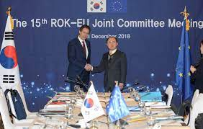
EU-Korea TSD chapter
Model for following one (inspired by US-Korea 2007; before: NAFTA side agreement)
After 2006 Global Europe Strategy
UNA Europa presentation

Slide 10

EU-Korea (zoom in)
Trade-related aspects of labor and environment
Should not use for protectionism
Right to regulate
Commitment to core ILO (child, forced, freedom, non-discrimination)
Commitment to existing MEAs
No dumping
UNA Europa presentation

Slide 11

EU-Korea TSD chapter
Binding (MEAs and ILO) - best-endeavour for high of environmental and labour protection, plus prohibition against lowering standards to promote trade Non-binding (CSR, resources)
Institutions (DAG, CTSD)
Dispute settlement
UNA Europa presentation

Slide 12
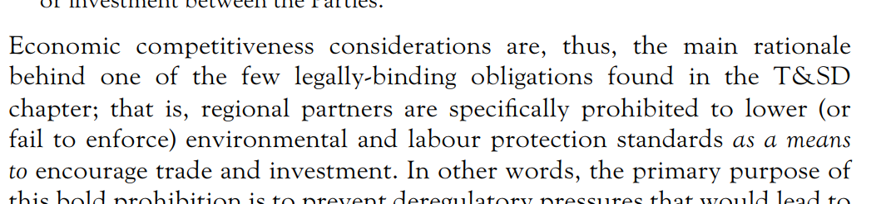
Appraisal of EU-Korea TSD chapter

Slide 13
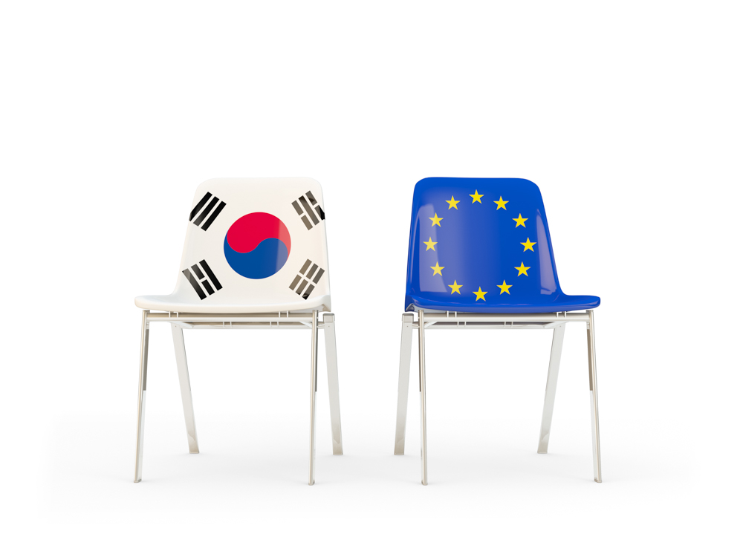
EU-Korea dispute on labour rights
Except as otherwise provided in this Chapter, this Chapter applies to measures adopted or maintained by the Parties affecting trade-related aspects of labour and environmental issues
UNA Europa presentation

Slide 14
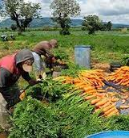
- digression: US-Guatemala dispute
Panel finds that US allegations do not relate to measures that affect trade, so rejects claim
UNA Europa presentation

Slide 15
EU-Korea dispute on labour rights
In case of core ILO rights, there’s an exception to the “trade” focus.
Korea found to breach FTA rules
UNA Europa presentation

Slide 16
2018 - European Economic and Social Committee. TSD chapters in EU FTA
  In the context of SDGs, the EESC would [recommend] to include in all future mandates for TSD chapters "a specific clause requiring both parties of each civil society monitoring mechanism to work together to promote the SDGs" and that TSD chapters "must be given equal weight to those covering commercial, technical or tariff issues".
The Committee has already noted that Sustainable Development Goal 17 specifically refers to the role of civil society, stating "a successful sustainable development agenda requires partnerships between governments, the private sector and civil society". For the first time in UN history as well, the SDGs specify that governments are answerable to the people.

Slide 17
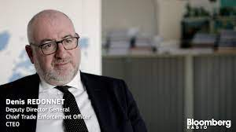
Ramped-up enforcement
  Enforcement strengthened. As set out in the Commission's 15-Point TSD Action Plan, and subsequently implemented with appointment of the Chief Trade Enforcement Officer and the announcement of the Single Entry Point where stakeholders can raise concerns as to implementation of these chapters.

Slide 18
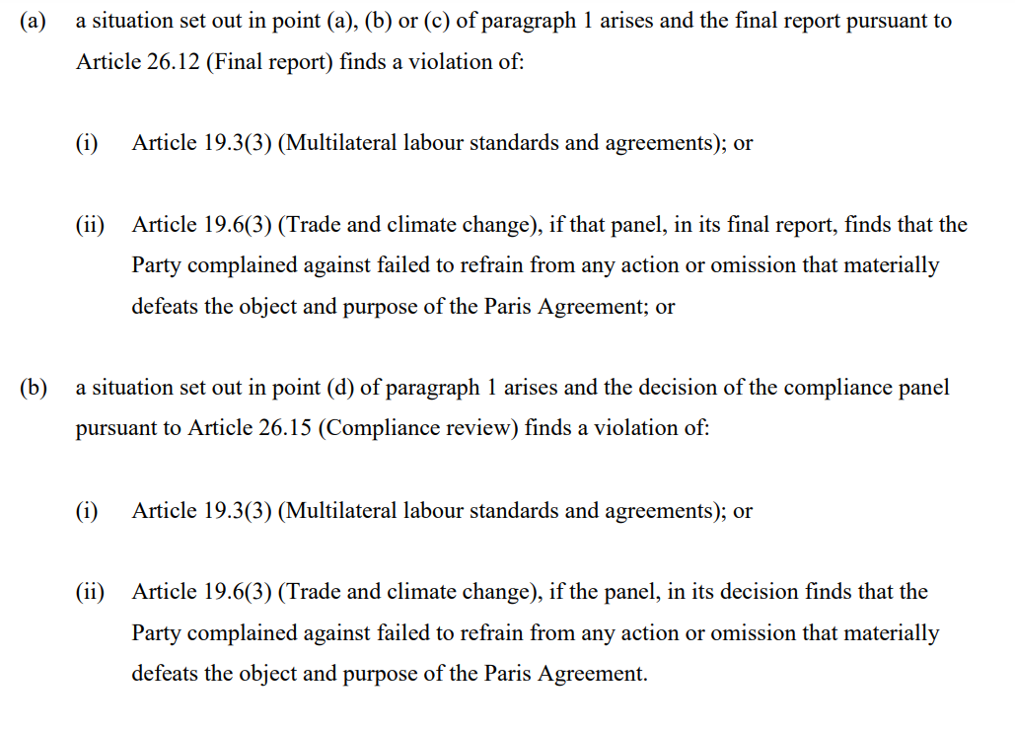
Full-on retaliation in EU-NZ FTA

Slide 19
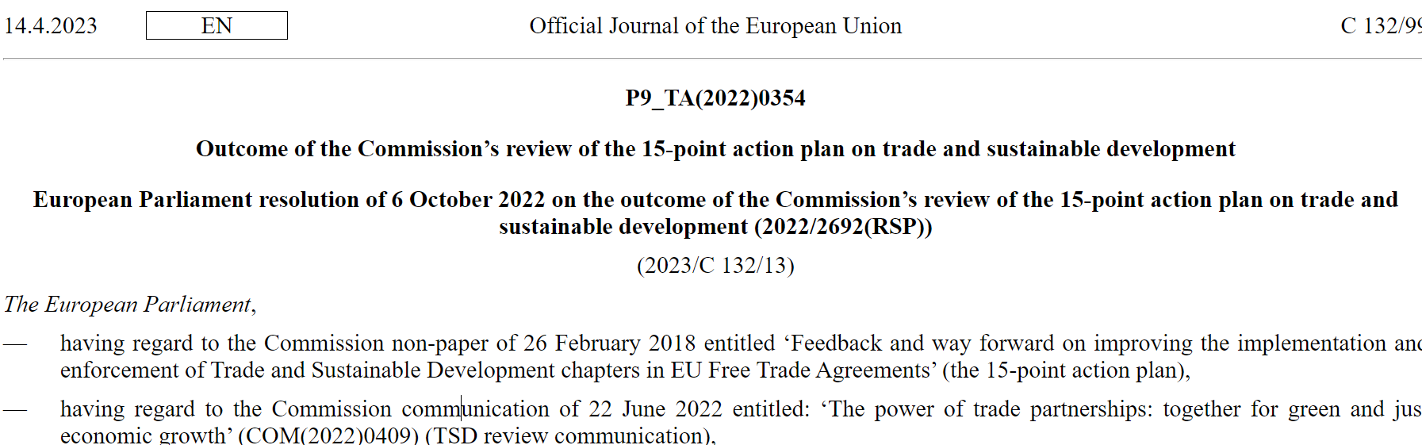
Parliament and Commission’s review of 15-step plan

Slide 20
2022 EU review of TSD in FTAs, within Green agenda
UNA Europa presentation

Slide 21
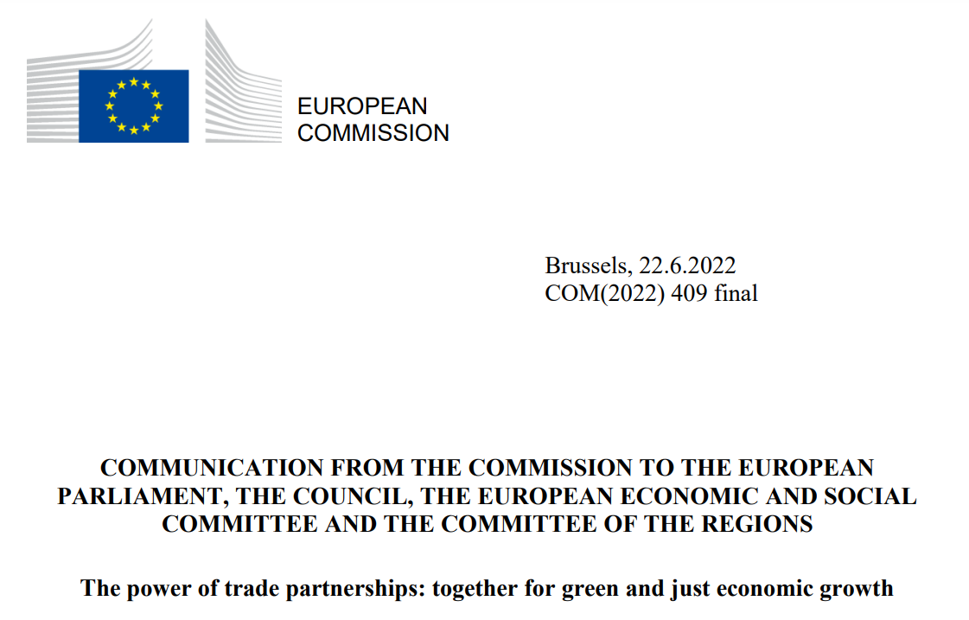
Commission 2022
More tailored
Liberalise sustainable goods/services further
More monitoring, including by civil society
Compliance and trade sanctions
UNA Europa presentation

Slide 22
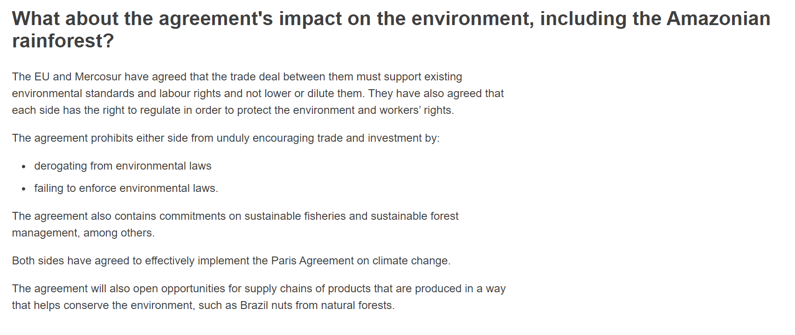
EU-Mercosur debate/leak

Slide 23
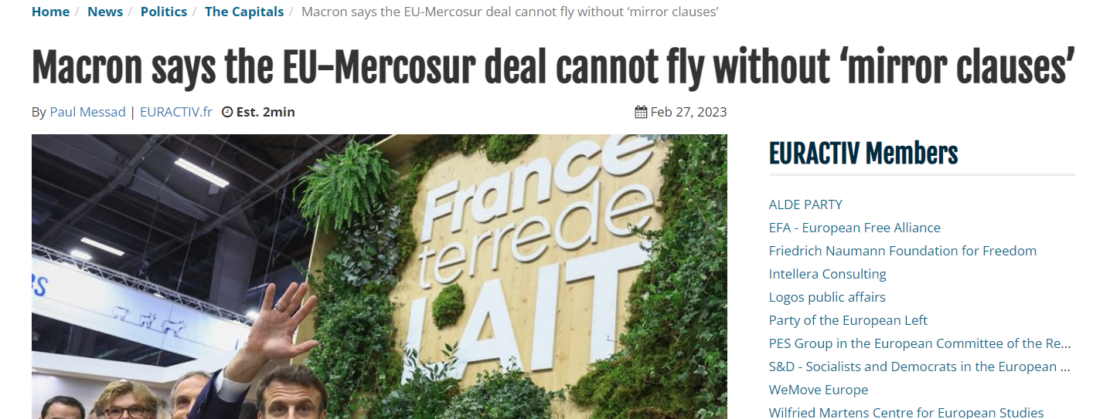
EU-Mercosur debate/leak

Slide 24
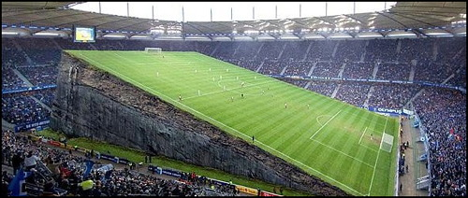
EU-UK TCA
Debate on regulatory divergence (new)
Is Canada model enough?
Insurance from UK threats to deregulate
UNA Europa presentation

Slide 25
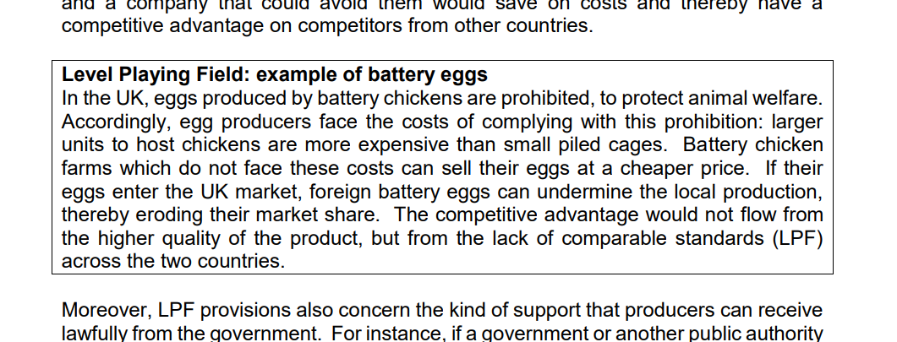
Level-playing field

Slide 26
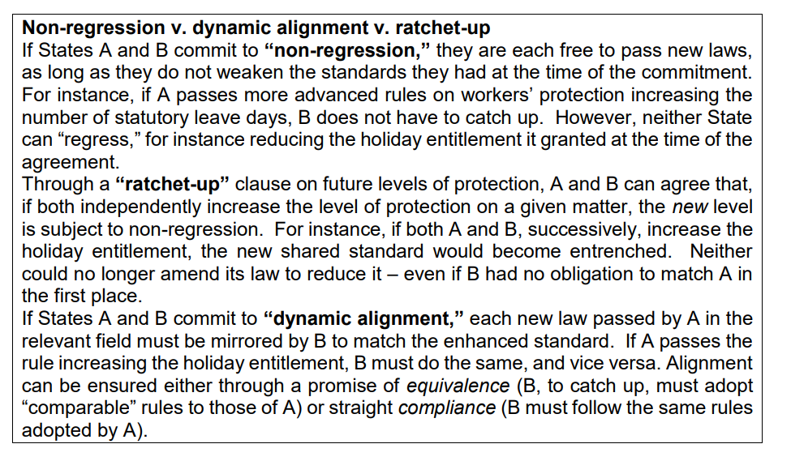
How to manage LPF
UNA Europa presentation

Slide 27
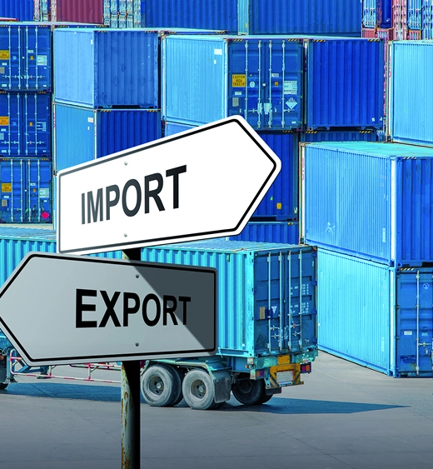
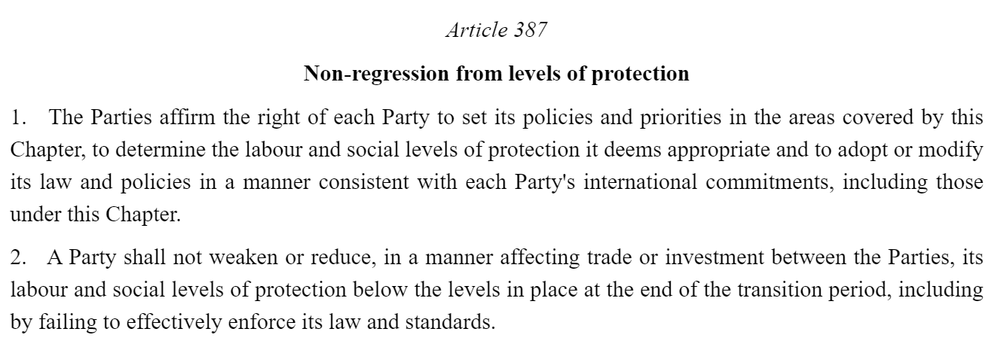
Narrow commitments

Slide 28

Mirror clauses?
France imports half of its need in lentils, with Canada being the largest lentil producer in the world. French farmers repeatedly complain about being undercut by Canadian lentils in the use of a pesticide that’s prohibited in the EU, and that would give Canadian producers a competitive edge.
UNA Europa presentation

Slide 29


Slide 30
@una_europa
#Una_Europa
Thanks!

